Slide 1
Predicting Customer Churn in the Telecom Industry Using Machine Learning Techniques
Presented by
Md. Al-amin
19CSE016

Slide 2
Contents
Introduction
Objective
Research Question
Factors Contributing to Customer Churn
Dataset
Methodology
Results
Conclusion and Future Work

Slide 3
Introduction
Customer churn refers to the phenomenon where customers stop using a company’s services.
Customer churn occurs when a customer stops using a company's services.
In the telecom sector, churn has a significant impact on revenue and customer satisfaction.
Predicting churn helps telecom companies retain customers proactively.
Machine learning provides tools to analyse patterns and predict churn effectively.

Slide 4
Objective
Understand Churn Patterns
Enhance Customer Retention Strategies
Improve Predictive Accuracy
Support Decision-Making
Optimise Resource Allocation

Slide 5
Research Question
What factors influence customer churn in the telecom industry?
Which machine learning models provide the best accuracy for churn prediction?
How can predictive insights improve customer retention strategies?

Slide 6
Factors Contributing to Customer Churn
Service Quality: Poor network coverage, unresolved complaints, and downtime lead to dissatisfaction.
Pricing Strategies: Uncompetitive pricing and hidden charges drive customers away.
Customer Demographics: Age, income, and usage patterns influence churn likelihood.

Slide 7
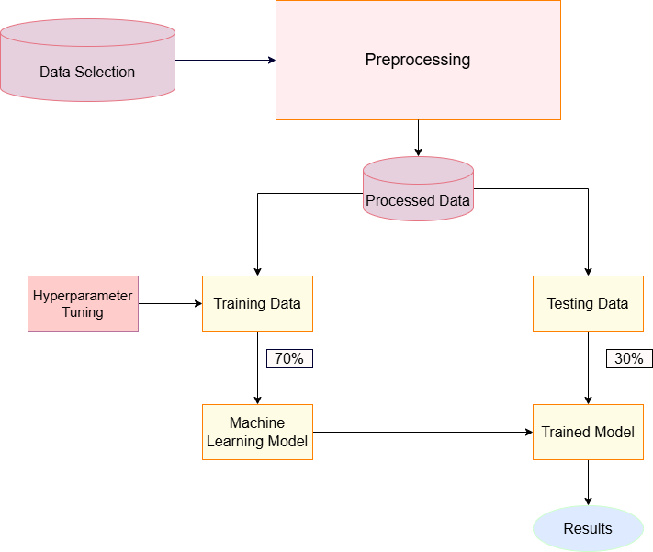
Methodology

Slide 8
Dataset Overview
The dataset contains customer demographics, service details, and account information.
Key features include tenure, monthly charges, contract type, and churn label.
It is widely used for benchmarking machine learning models in churn prediction.

Slide 9
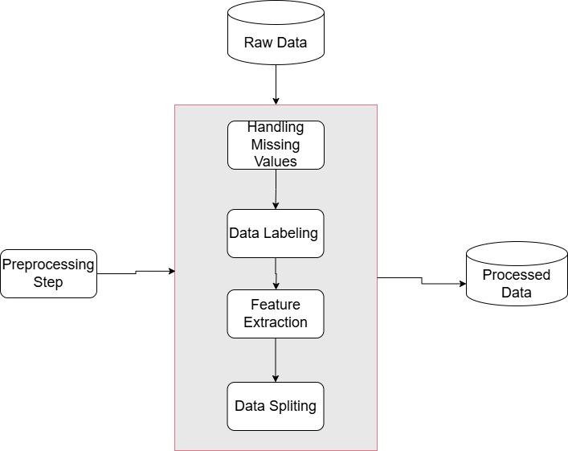
Data Preprocessing

Slide 10
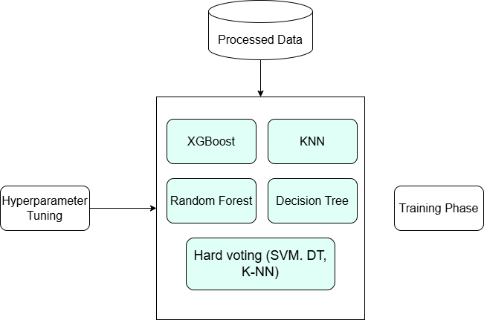
Models Used for Training

Slide 11
Evaluation Metrics
Accuracy: Measures the overall correctness of the predictions.
Precision: Indicates how many predicted churn cases are actual churn cases.
Recall: Reflects the model's ability to detect true churn cases.
F1-Score: A harmonic mean of precision and recall, balancing both metrics.

Slide 12
Results
XGBoost: Achieved the highest accuracy and F1-score.
Random Forest: Robust performance with good recall.
Decision Tree: Easy to interpret but lower accuracy.
k-NN: Served as a baseline model with lower precision and recall.

Slide 13
Comparison with Previous Work
Machine learning models outperform traditional statistical methods.
XGBoost and Random Forest models show significant improvements in prediction accuracy.
Ensemble techniques provide better generalisation on imbalanced datasets.

Slide 14
Conclusion
Machine learning effectively predicts customer churn, aiding retention strategies.
XGBoost and Random Forest are the best-performing models for this dataset.
Future efforts should focus on incorporating additional data sources and real-time analysis.

Slide 15
Future Work
Use customer feedback and satisfaction surveys to enhance features.
Develop real-time churn prediction systems for immediate intervention.
Test models on different telecom datasets for broader applicability.

Slide 16
Thank You

Slide 17
References
Alpaydin, E. (2020). Introduction to Machine Learning. MIT Press.
Breiman, L. (2001). "Random forests." Machine Learning, 45(1), 5-32.
Chen, T., & Guestrin, C. (2016). "XGBoost: A scalable tree boosting system." Proceedings of the 22nd ACM SIGKDD International Conference on Knowledge Discovery and Data Mining.

